Slide 1
CSC4500 Databases
Jared H & Jared R

Slide 2
What businesses did we build a database for?

Slide 3
All Sports Business Desc [Jared H]
Company: All Sports
Business Profile:
Small business located in Batavia, IL
Has 2 locations
30 Employees
What Do They Do?: Small business that sells licensed sporting goods and merchandise at convenience stores
Items like shirts, keychains, stickers, & more
Also want to branch out to other stuff from the likes of Disney, Marvel, DC.

Slide 4
The Pet Place Business Desc [Jared R]
Pet care
Grooming, daycare, and training
Track data on pets, owners, employees, visit info, store info, department, and service descriptions
Need to know pet age, behavior, name, etc.
Owner contact info

Slide 5
Why do these businesses need a database?

Slide 6
Business Need [Jared H]
Business was using pen & paper to record their products
No way to view images of past & present products
Only had names and descriptions
Customers wanted to view what products were available without calling in
Want a way to allow customers to view items whenever they want and see current stock of any given item

Slide 7
Business Need [Jared R]
Weren't tracking pet or owner information at all before now
Had to obtain owner and pet info every visit
With database, can register and provide service efficiently

Slide 8
DB Building Process

Slide 9
Build Process Part #1 [Jared H]
Assess Business Need
Create ER Diagram
Create Tables
Insert Test Data
Develop Business Queries
Create Web Connection

Slide 10
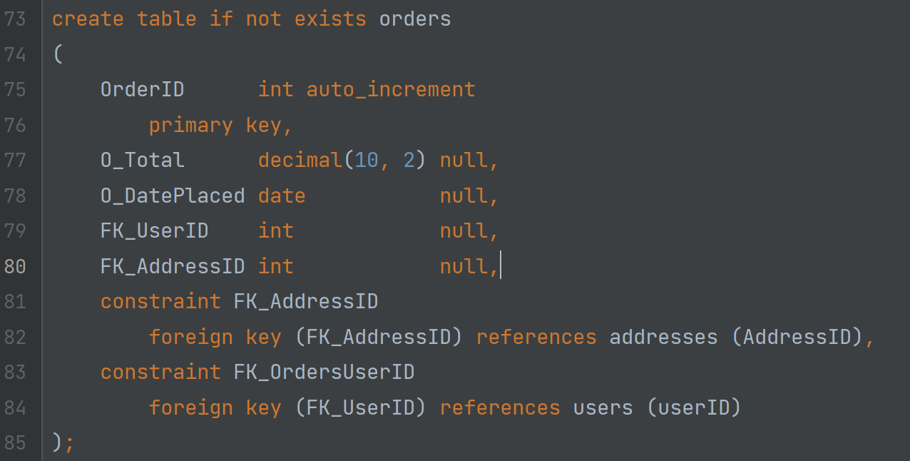
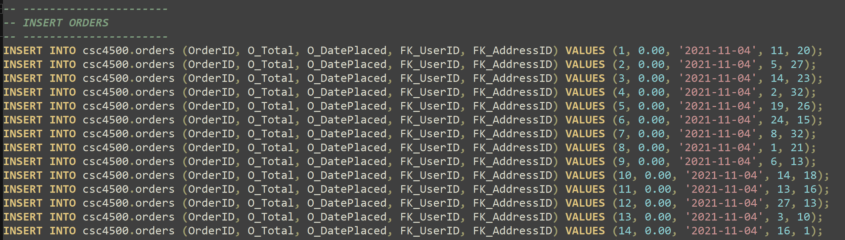
Build Process Part #2 [Jared H]

Slide 11
Build Process Part #1 [Jared R]
Learn what data needed to be tracked
Created ER diagram
Normalized the data
Created tables
Inserted data
Re-reviewed tables and data
Business queries
Web connection

Slide 12
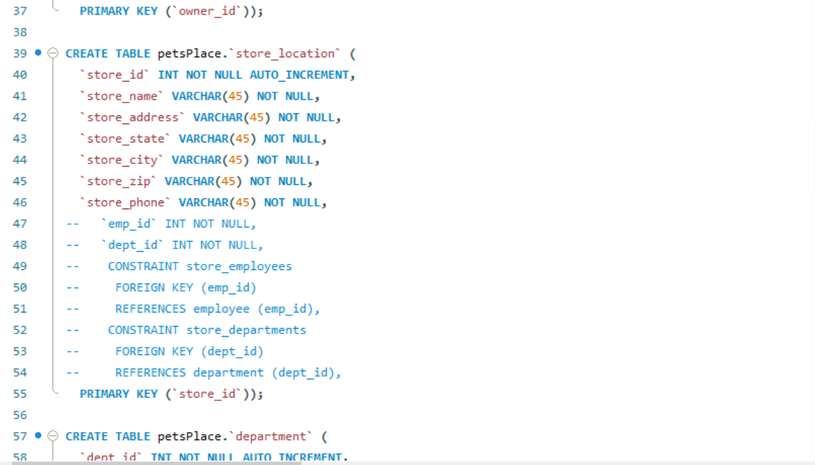
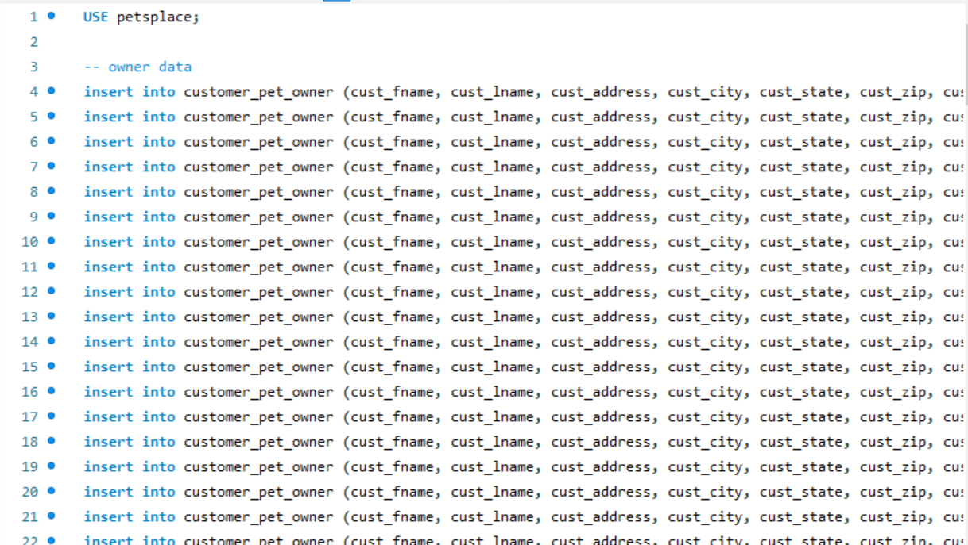
Build Process Part #2 [Jared R]
[screenshot of create statements & insert statements?]

Slide 13
Final Product
ER Diagram, Screenshots, Queries, & More

Slide 14
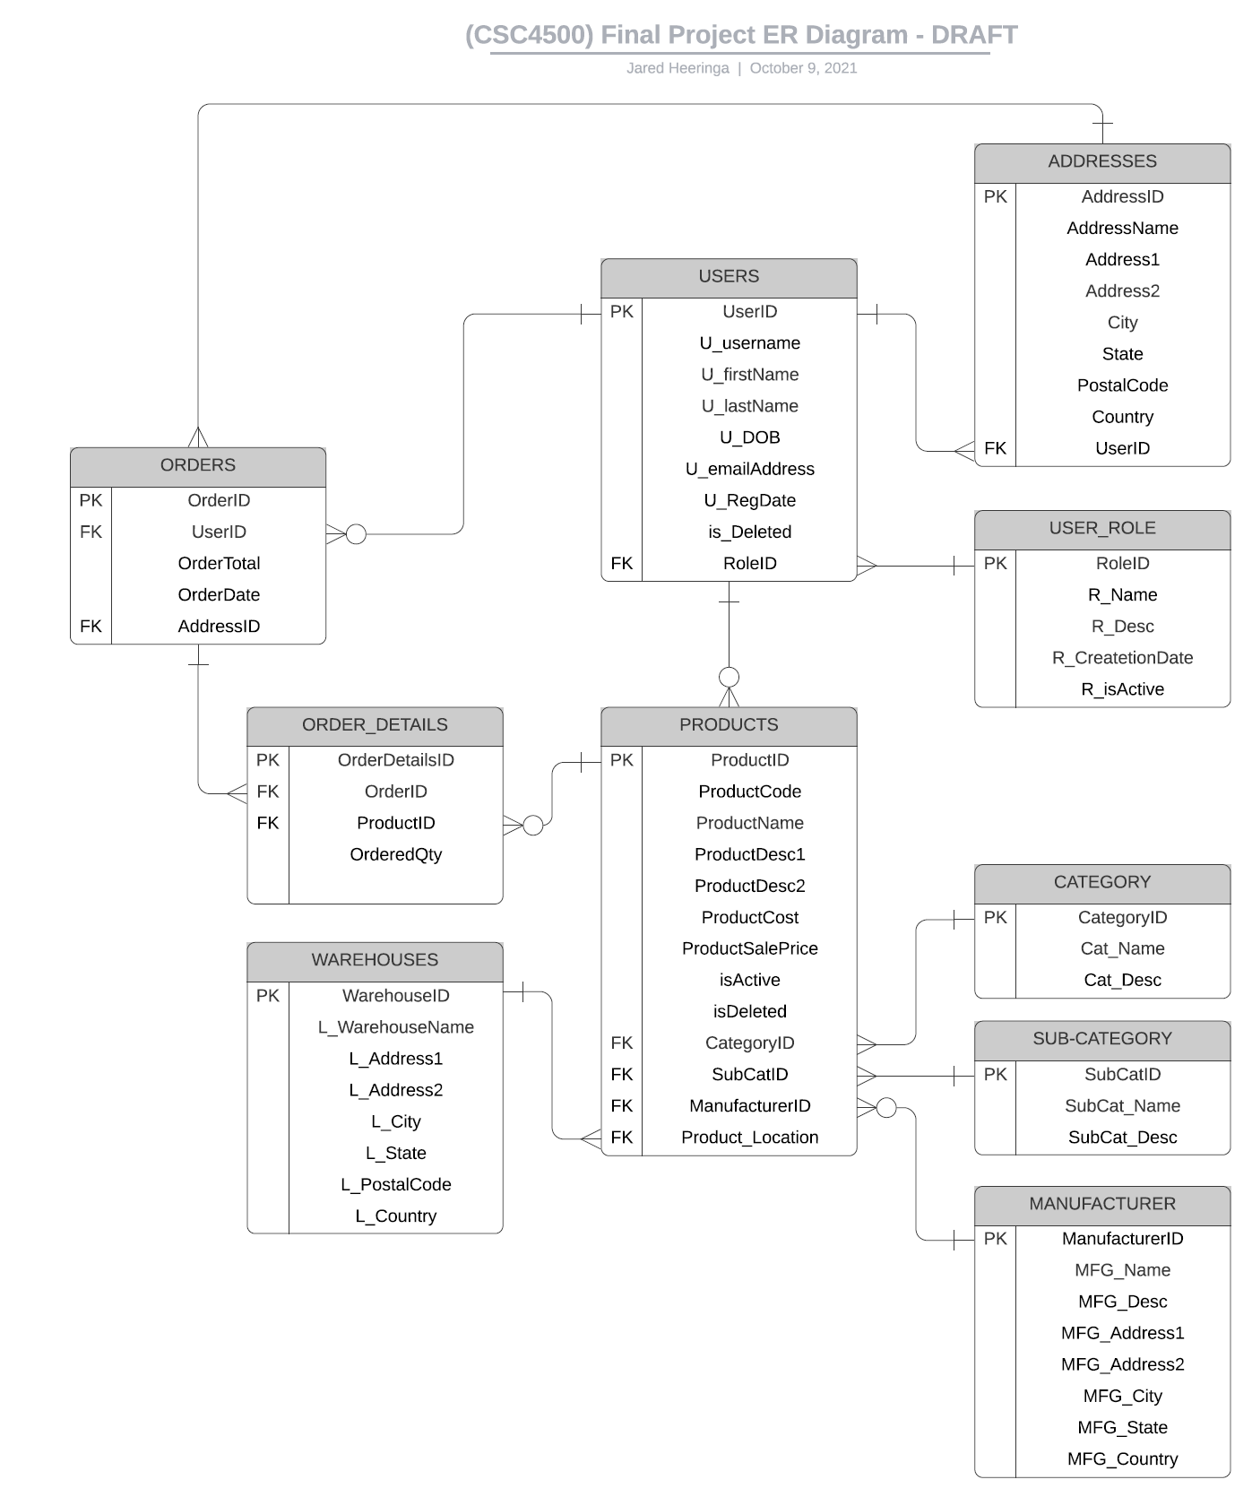
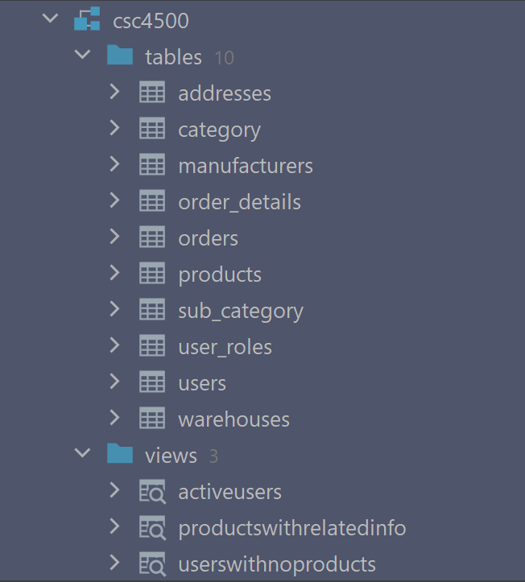
Final Product Part #1 [Jared H]

Slide 15
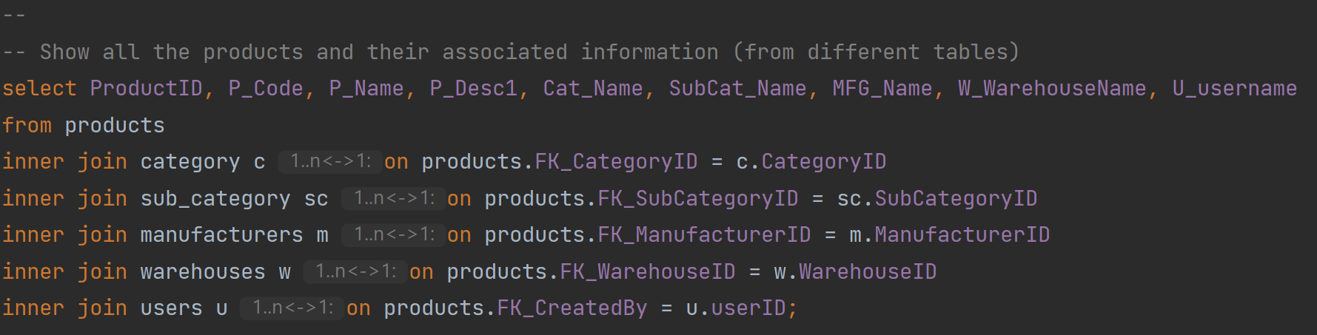
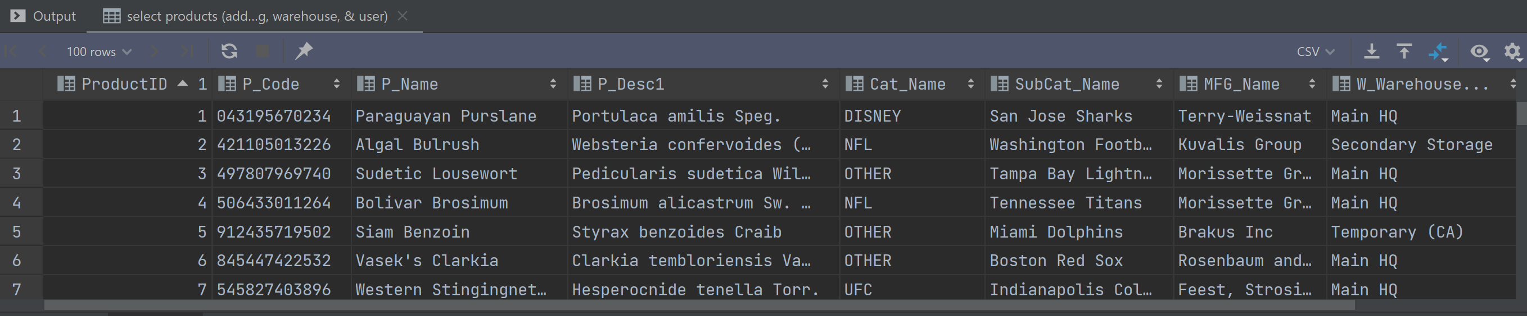
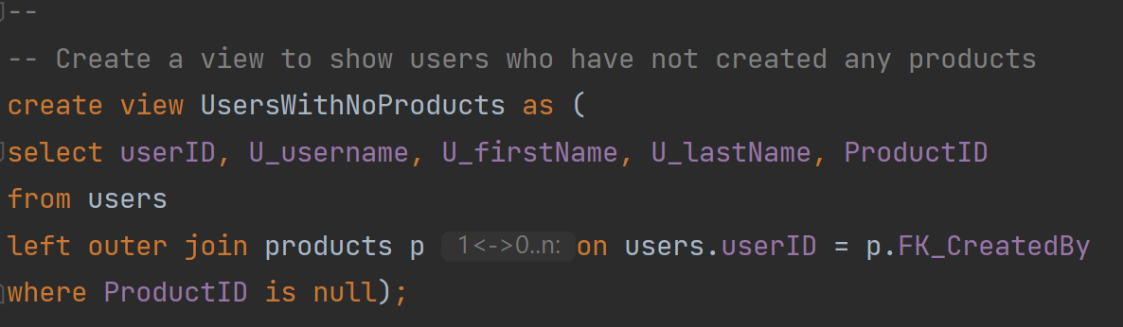
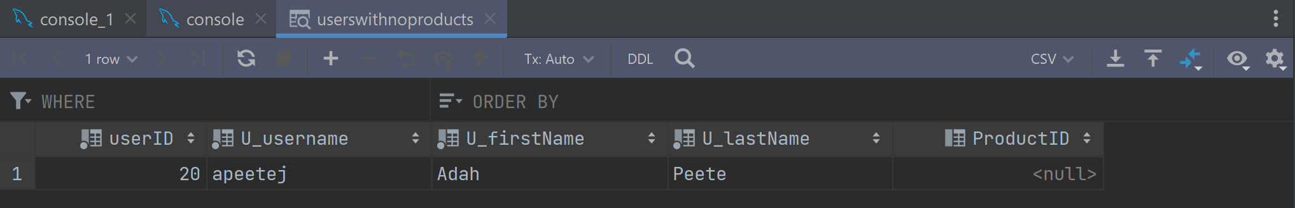
Final Product Part #2 [Jared H]

Slide 16
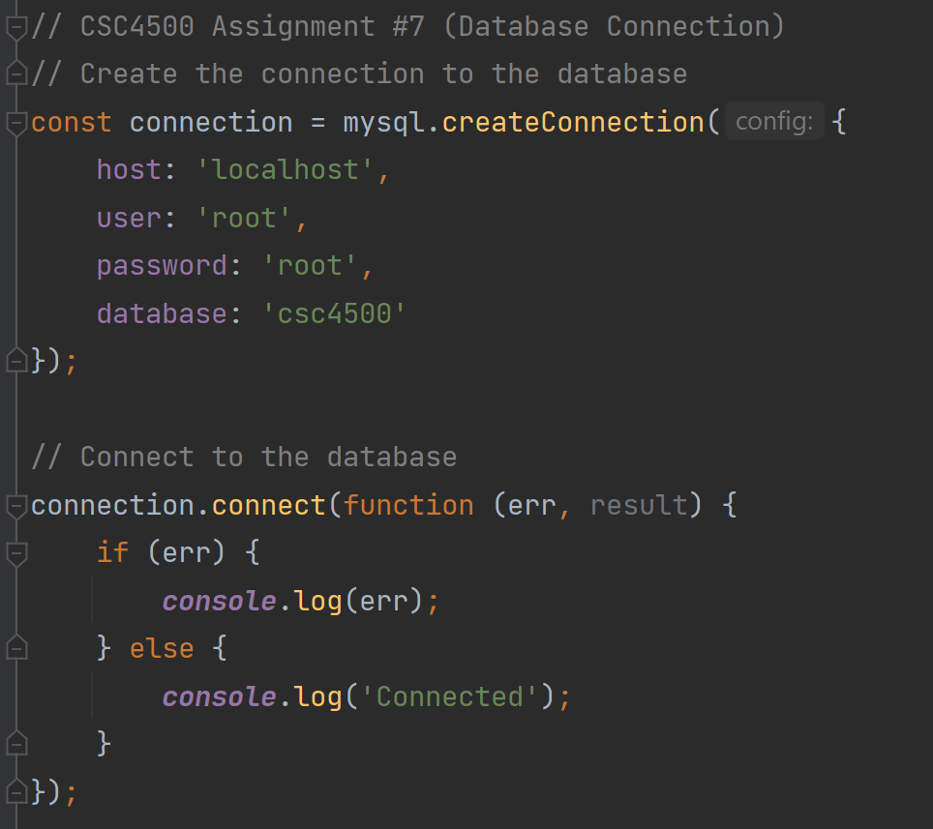
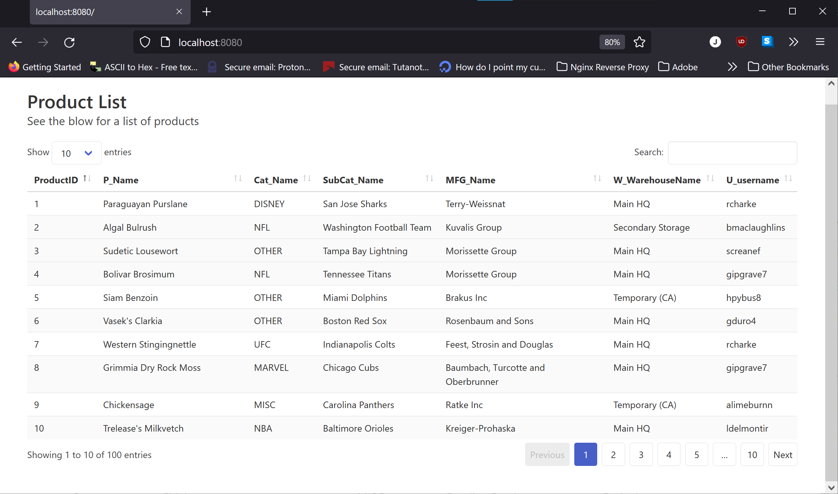
Final Product Part #3 [Jared H]

Slide 17
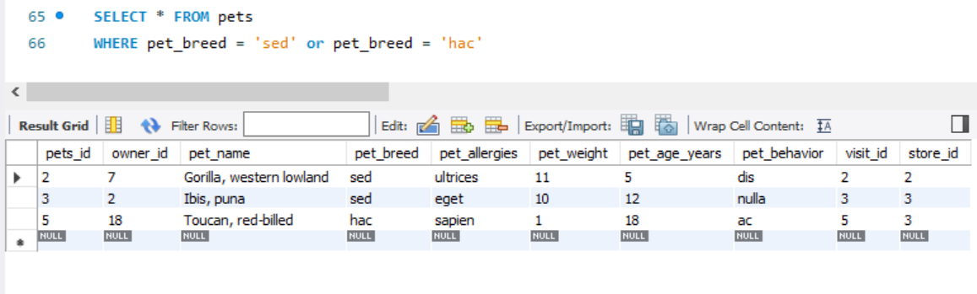
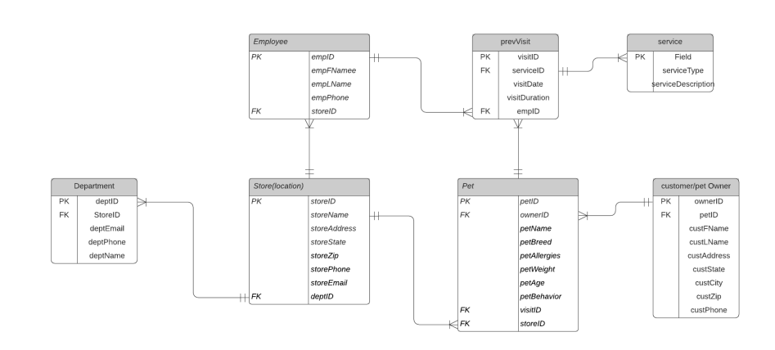
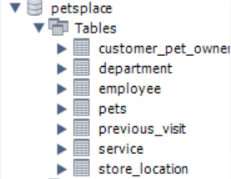
Final Product Part #1 [Jared R]

Slide 18
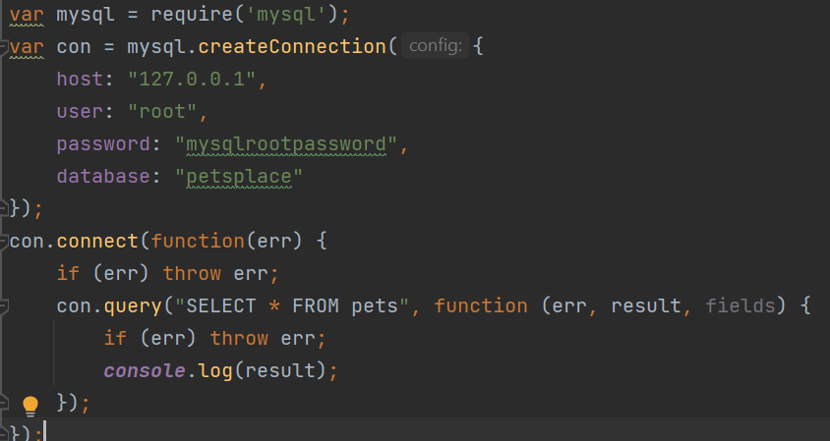
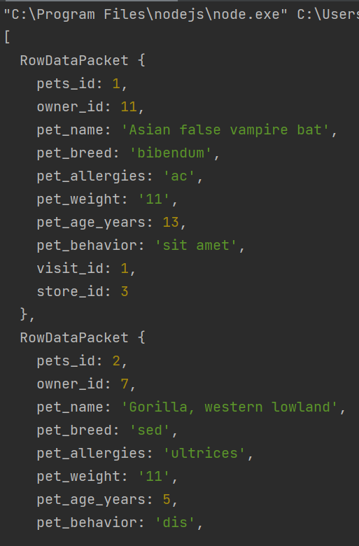
Final Product Part #2? [Jared R]

Slide 19
Challenges / Changes

Slide 20
Challenges & Changes [Jared H]
DB Challenges
What would I do differently?
Filling tables with dummy data
More specifically: Trying to fill a Bridge/Associative table with dummy data
SQL queries with sub-queries and outer joins
More time? Add more tables for stuff like images
Better/more featured web connection
Explore other DB options (graphs, documents, etc.)

Slide 21
Challenges & Changes [Jared R]
DB Challenges
What would I do differently?
How to link the stores and departments together
Change how previous visits and services are recorded

Slide 22
CSC4500 Databases
The End

